Slide 1




TACTICAL COMBAT CASUALTY CARE COURSE
MODULE 14: EYE INJURIES
Module 14: Eye Injuries
#TCCC-CPP-PPT-12 08 AUG 23
COMBAT PARAMEDIC/ PROVIDER
TCCC TIER 1
All Service Members
TCCC TIER 2
Combat Lifesaver
TCCC TIER 3
Combat Medic/Corpsman
TCCC TIER 4
Combat Paramedic/Provider

Slide 2




Module 14: Eye Injuries
TACTICAL COMBAT CASUALTY CARE (TCCC) ROLE-BASED TRAINING SPECTRUM
ROLE 1 CARE
NONMEDICAL PERSONNEL
MEDICAL PERSONNEL
YOU ARE HERE
STANDARDIZED JOINT CURRICULUM
#TCCC-CPP-PPT-12 08 AUG 23
2
Notes:
As a Combat Paramedic/Provider, it is important that you understand the roles and responsibilities of both the nonmedical personnel (All Service Members (ASM) and Combat Lifesaver (CLS) and medical personnel (Combat Medic/Corpsman CMC)) who may be assessing casualties and providing care/assisting in the assessment and initial treatment of casualties with eye injuries in the prehospital environment.

Slide 3
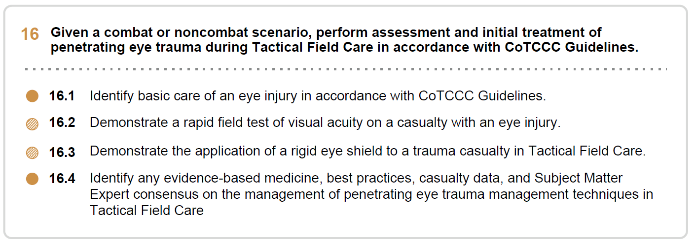









Module 14: Eye Injuries
1 x TERMINAL LEARNING OBJECTIVES
16
Given a combat or noncombat scenario, perform assessment and initial treatment of penetrating eye trauma during Tactical Field Care in accordance with CoTCCC Guidelines.
  Identify basic care of an eye injury in accordance with CoTCCC Guidelines.
  Demonstrate a rapid field test of visual acuity on a casualty with an eye injury.
16.3
16.4
Demonstrate the application of a rigid eye shield to a trauma casualty in Tactical Field Care.
Identify any evidence-based medicine, best practices, casualty data, and Subject Matter Expert consensus on the management of penetrating eye trauma management techniques in Tactical Field Care
04 x ENABLING LEARNING OBJECTIVES
#
= Terminal Learning Objectives
= Cognitive ELOs
= Performance ELOs
#TCCC-CPP-PPT-12 08 AUG 23
3
Notes:
There are two cognitive learning objectives and two performance learning objectives for the Eye Injuries module.
The cognitive learning objectives are to identify the basic care of an eye injury in accordance with CoTCCC Guidelines and to describe the evidence supporting the management strategies and limitations of penetrating eye trauma management techniques in Tactical Field Care.
The performance learning objectives are to demonstrate a rapid field test of visual acuity and demonstrate the application of a rigid eye shield on a trauma casualty with an eye injury.

Slide 4
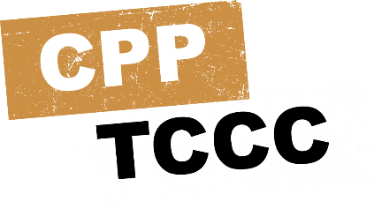
MARCH PAWS
Module 14: Eye Injuries
LIFE-THREATENING
AFTER LIFE-THREATENING
PAIN ANTIBIOTICS
WOUNDS SPLINTING
M A R C
MASSIVE BLEEDING
#1 Priority
P A W S
AIRWAY
RESPIRATION (Breathing)
CIRCULATION
H
HYPOTHERMIA / HEAD INJURIES
#TCCC-CPP-PPT-14 08 AUG 23
4
Notes:
Assessment and management of eye injuries is part of the “H” in the MARCH PAWS sequence (included with head injuries).
REMEMBER:
You are now in Tactical Field Care which affords the relative safety and time to expand the focus of assessment and management beyond immediate life-threatening hemorrhage control to treatment of other injuries and prevention of potential complications including the treatment of eye injuries.

Slide 5

Module 14: Eye Injuries
EYE INJURIES OVERVIEW
Video can be found on deployedmedicine.com
#TCCC-CPP-PPT-14 08 AUG 23
5
Notes:
This video provides an overview of traumatic eye injuries.

Slide 6


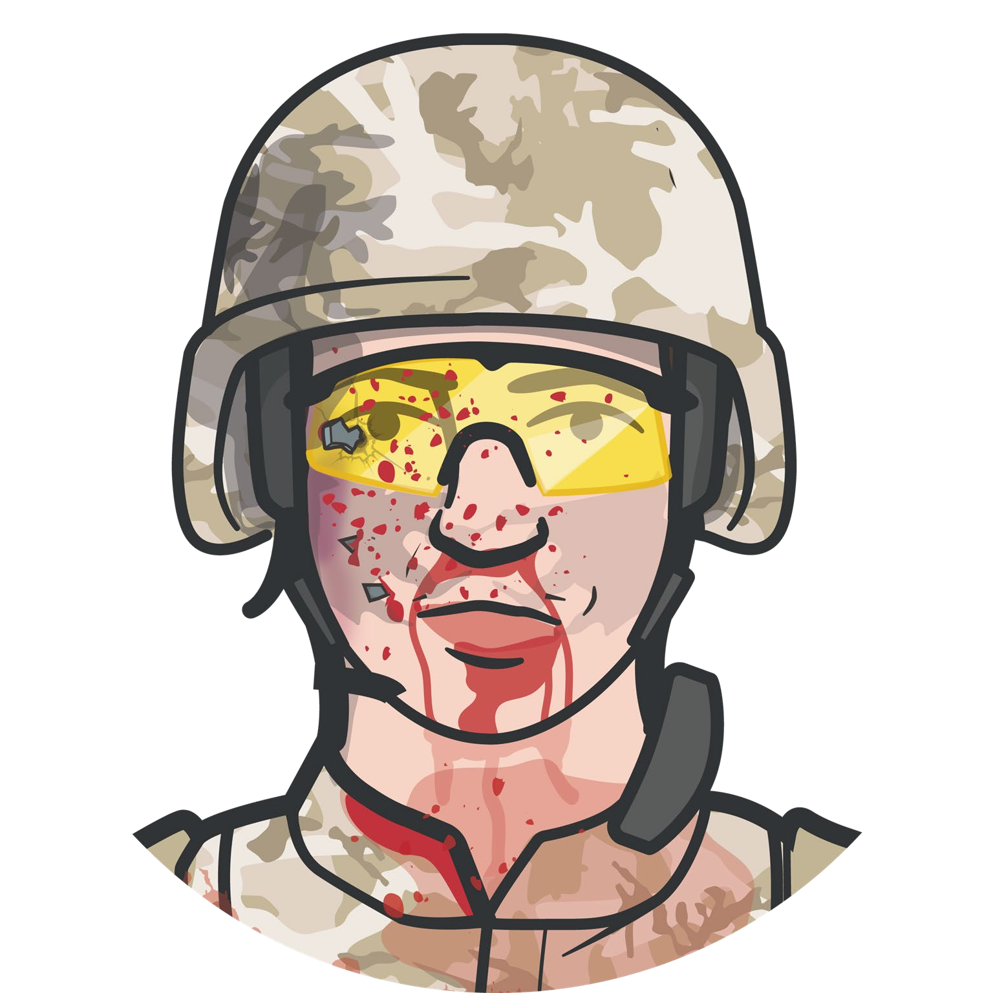
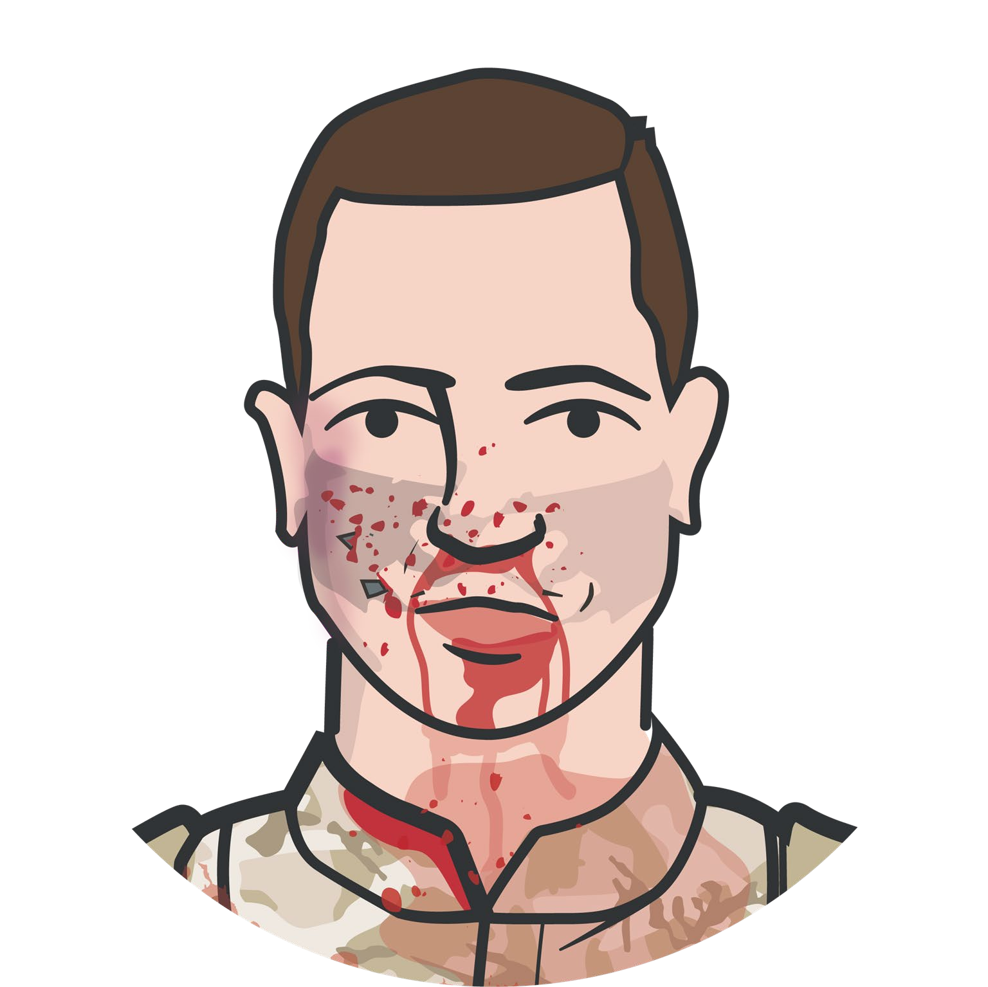

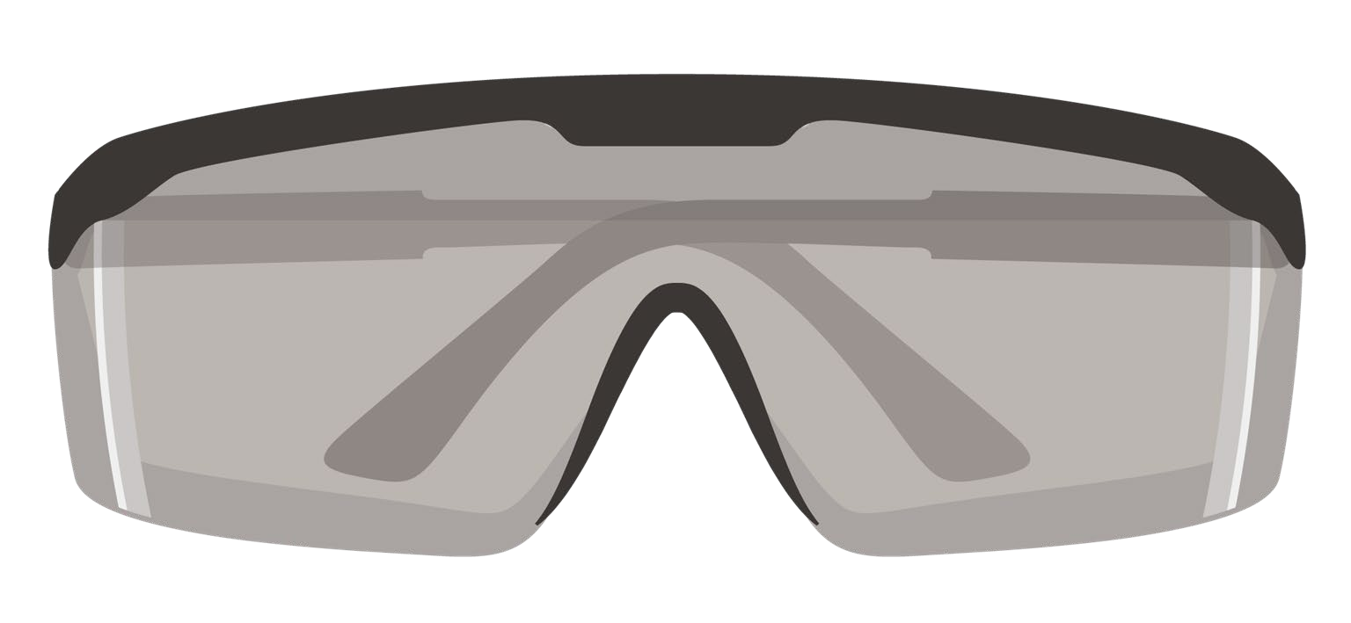
Module 14: Eye Injuries
PREVENTION PENETRATING EYE INJURY
Using tactical eyewear in the field will generally prevent the eye injury from happening in the first place!
M A R C
H
#TCCC-CPP-PPT-12 08 AUG 23
6
Notes:
Traumatic eye injuries can occur both in training and combat operations and can lead to significant vision loss and blindness if not identified and treated in the prehospital environment. Eye injuries should be evaluated after other life-threatening injuries have been addressed.
It is important to remember that most eye injuries are preventable by wearing unit-issued protective eyewear.^{1, 2} Approved protective eyewear is very effective in stopping most metal fragments and other foreign bodies from explosions, etc. that cause the majority of eye injuries.

Slide 7



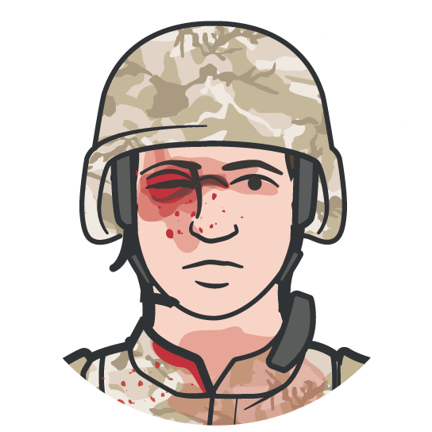
WHEN TO SUSPECT A PENETRATING EYE INJURY
Module 14: Eye Injuries
VISION VISION
Bleeding surrounding the eye, inside the globe of the eye, or coming from the globe of the eye
Obvious penetration of shrapnel or foreign bodies into the globe of the eye or eye socket
Objects protruding from the globe of the eye
Swelling or lacerations of the globe of the eye
Protrusion of the globe of the eye from the eye socket
Reduced vision and swelling of the eye area
Misshapen or distorted parts of the eye from normal
1
2
M A R C
H
#TCCC-CPP-PPT-12 08 AUG 23
7
Notes:
Vision is one of our most important senses. Damage to an eye from trauma can be irreversible and lead to permanent loss of vision or blindness if not identified and treated appropriately and as early as possible.
The following signs should make you suspect an eye injury:
Bleeding surrounding the eye, inside the globe of the eye, or coming from the globe of the eye
Obvious penetration of shrapnel or other foreign bodies into the globe of the eye or surrounding eye socket
Objects protruding from the globe of the eye
Swelling or lacerations of the globe of the eye
Protrusion of the globe of the eye from the eye socket
Reduced vision and swelling of the eye area
Misshapen or distorted parts of the eye from normal

Slide 8

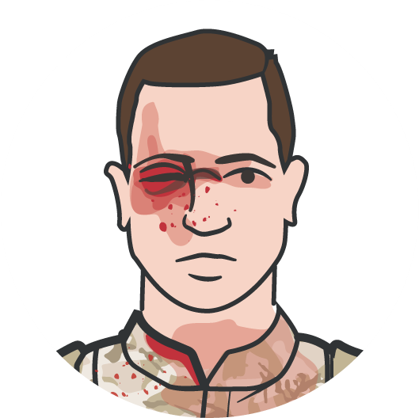



WHEN A PENETRATING EYE INJURY IS NOTED OR SUSPECTED
Module 14: Eye Injuries
1
Perform a RAPID FIELD TEST OF VISUAL ACUITY and
document findings
2
COVER THE AFFECTED EYE with a rigid eye shield (NOT a pressure patch)
3
ADMINISTER the casualty’s complete Combat Wound Medication Pack (CWMP) or IV/IO/IM antibiotics if unable to swallow
REMEMBER Document all findings (including visual acuity) and treatments on the casualty’s DD Form 1380
M A R C H
REMEMBER ALL suspected penetrating eye injuries should be evacuated as soon as possible
4
#TCCC-CPP-PPT-12 08 AUG 23
8
Notes:
If a penetrating eye injury is noted or suspected, three steps must be taken:
1. Perform a rapid field test of visual acuity and document findings.
Rapid visual acuity testing includes the ability to read print, count fingers, identify hand motion, and/or differentiate light from dark.
2. Cover the affected eye with a rigid eye shield, NOT a pressure patch.
A pressure dressing could result in permanent loss of vision.
Place a rigid eye shield on only one eye, unless both eyes are injured.
Covering both eyes turns an otherwise ambulatory casualty into a litter casualty.
Tactical eyewear is a good way to prevent eye injuries and can also be used for covering an injured eye if no eye shield is available.
3. Administer the casualty’s complete Combat Wound Medication Pack (CWMP), including all the medications contained in it.
One of the medications is 400 mg of moxifloxacin, which is administered for eye injuries to prevent infection.
IV/IM/IO antibiotics should be administered if oral moxifloxacin cannot be taken by the casualty.
Penetrating eye trauma may not always be obvious injuries from bullets or shrapnel.
REMEMBER:
Document all findings (including visual acuity) and treatments on the casualty’s DD Form 1380.
A cut or laceration of the eye can be subtle and have the same effect allowing contents to leak from the eye. If left untreated, even apparently minor eye injuries can become infected and cause loss of vision or even blindness.
ALL suspected penetrating eye injuries should be evacuated to a higher level of care as quickly as possible.

Slide 9


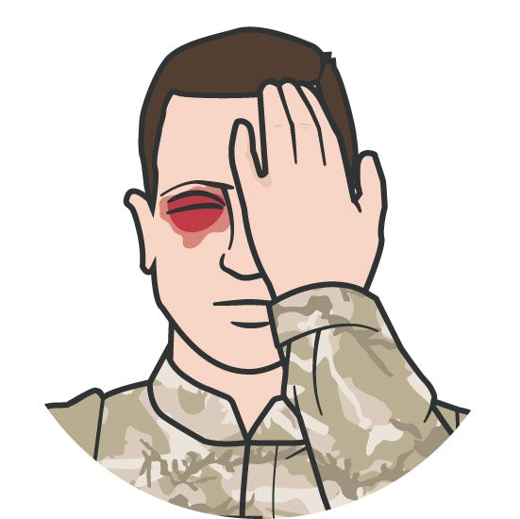




RAPID VISUAL ACUITY TESTING
Module 14: Eye Injuries
RAPID VISUAL ACUITY TESTING includes
testing the casualty’s ability to read print, count fingers, identify hand motion, or differentiate light from dark
Rapid Visual Acuity Testing is NOT a formal vision screening with a Snellen Eye Chart
DO NOT force open a swollen eye to conduct a field visual acuity test
REMEMBER to document all findings (including visual acuity for both eyes) on a DD Form 1380 TCCC Casualty Card
Level of Evidence: B-NR
M A R C H
#TCCC-CPP-PPT-12 08 AUG 23 9
Notes:
Rapid visual acuity testing is NOT a formal vision screening with a Snellen Eye Chart.³ It is a rapid assessment and includes testing the casualty’s ability to read print, count fingers, identify hand motion, or differentiate light from dark.
Have the casualty cover the unaffected eye. Do not force open a swollen eye to conduct a field visual acuity test.
At an arm’s length, assess the casualty’s ability to:
Read something with text on it (that you hold up).
If unable to read print, ask the casualty to count fingers.
If unable to count fingers, ask the casualty to identify hand motion (by waving a hand in front of the affected eye).
If unable to identify hand motion, ask the casualty to differentiate light from dark (by covering and then uncovering the affected eye).
Repeat the procedure for the other eye.
Determine visual acuity based on what the casualty can see (i.e., can count fingers at 2 feet).
Remember to document all findings (including visual acuity for both eyes) and treatments on a DD Form 1380 TCCC Casualty Card and attach it to the casualty.
The importance of documenting visual acuity as soon as possible after a traumatic injury has been well documented in the literature.
The level of evidence supporting the guidance for the use of rapid field tests of visual acuity is based on retrospective and observational studies.

Slide 10

Module 14: Eye Injuries
RAPID FIELD VISUAL ACUITY TEST
Video can be found on deployedmedicine.com
#TCCC-CPP-PPT-12 08 AUG 23 10
Notes:
This video demonstrates how to perform rapid field visual acuity testing on a casualty with a suspected traumatic eye injury. Note that this assessment can be performed quickly and easily. The results should be documented on the casualty’s DD Form 1380.

Slide 11
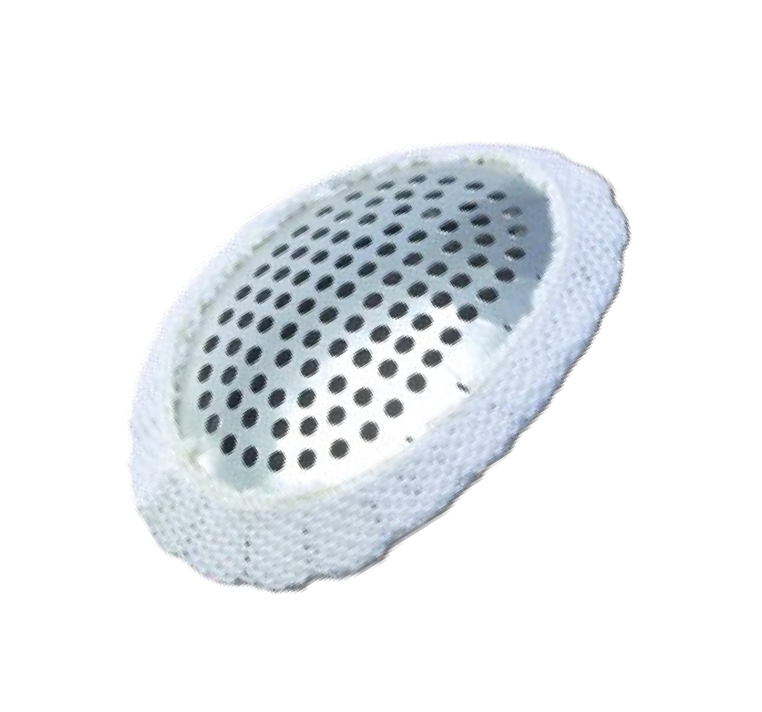
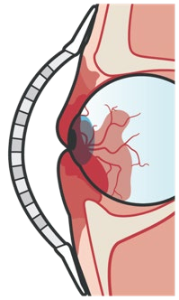
RIGID EYE SHIELD
Module 14: Eye Injuries
APPLY A RIGID EYE SHIELD
Alternatively, an improvised eye shield or unit-issued protective eyewear can be used to protect an injured eye
IMPORTANT!
DO NOT APPLY PRESSURE
Avoid/prevent manipulation, pressure, or additional trauma to the eye that might cause further damage
Pressure on the eye could force the interior contents of the eye out of the eyeball through a cut or laceration
Rigid Eye Shield
Level of Evidence: C-LD
M A R C H
#TCCC-CPP-PPT-12 08 AUG 23 11
Notes:
When eye trauma is suspected, it is critically important to prevent manipulation or additional trauma that might cause further damage to the eye. This can be accomplished by using a rigid shield to cover and protect the injured eye. It is important that you do NOT apply pressure to the eye. Pressure could force the interior contents of the eye to come out of the eyeball. Pressure dressings are NOT part of the care of a traumatic eye injury and may result in permanent loss of vision.
The need to protect the traumatically injured eye from further damage or manipulation with a rigid eye shield is well documented as subject matter expert consensus in textbooks, literature, and consensus guidelines.^{5, 6, 7, 8}
The level of evidence supporting the guidance for the application of a rigid eye shield is based on subject matter expert consensus.

Slide 12

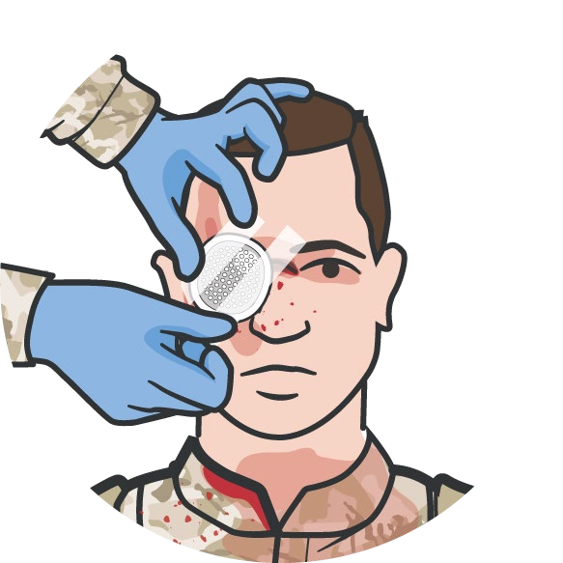
APPLYING A RIGID EYE SHIELD
Module 14: Eye Injuries
RIGID EYE SHIELD is found in the casualty’s JFAK and most medical kits
Secure the rigid eye shield with tape at
45-degree angles across the forehead and cheek
If rigid eye shield is not available, use an improvised eye shield or tactical protective eyewear to cover and protect the injured eye
Do NOT apply any pressure or cover both eyes unless both eyes are injured
M A R C
H
#TCCC-CPP-PPT-12 08 AUG 23 12
Notes:
A commercially-available rigid eye shield can be found in the casualty’s JFAK and most medical kits. Secure the rigid eye shield over the eye with tape at 45-degree angles across the forehead and cheek.
For protruding or impaled objects extending past the eye shield, cut a hole in the eye shield to allow the object to fit through and secure it in place. If the eye shield cannot be applied around the impaled object, use an improvised eye shield (Styrofoam or paper cup, etc.) to protect and avoid pressure or further damage to the injured eye.
DO NOT ATTEMPT TO REMOVE.
Rigid eye shields should be placed over both eyes ONLY when you are sure or at least strongly suspect that both eyes have been injured. When only one eye has been injured, do not place an eye shield over the unaffected eye to prevent eye movement. Movement has not been shown to worsen the outcome for the injured eye. Blindness, resulting from placing eye shields over both eyes unnecessarily, is psychologically stressful and makes an otherwise ambulatory casualty a litter casualty.
Unit-issued protective eyewear can be used to protect the injured eye from further trauma, manipulation, or pressure if no other eye shield is available.

Slide 13

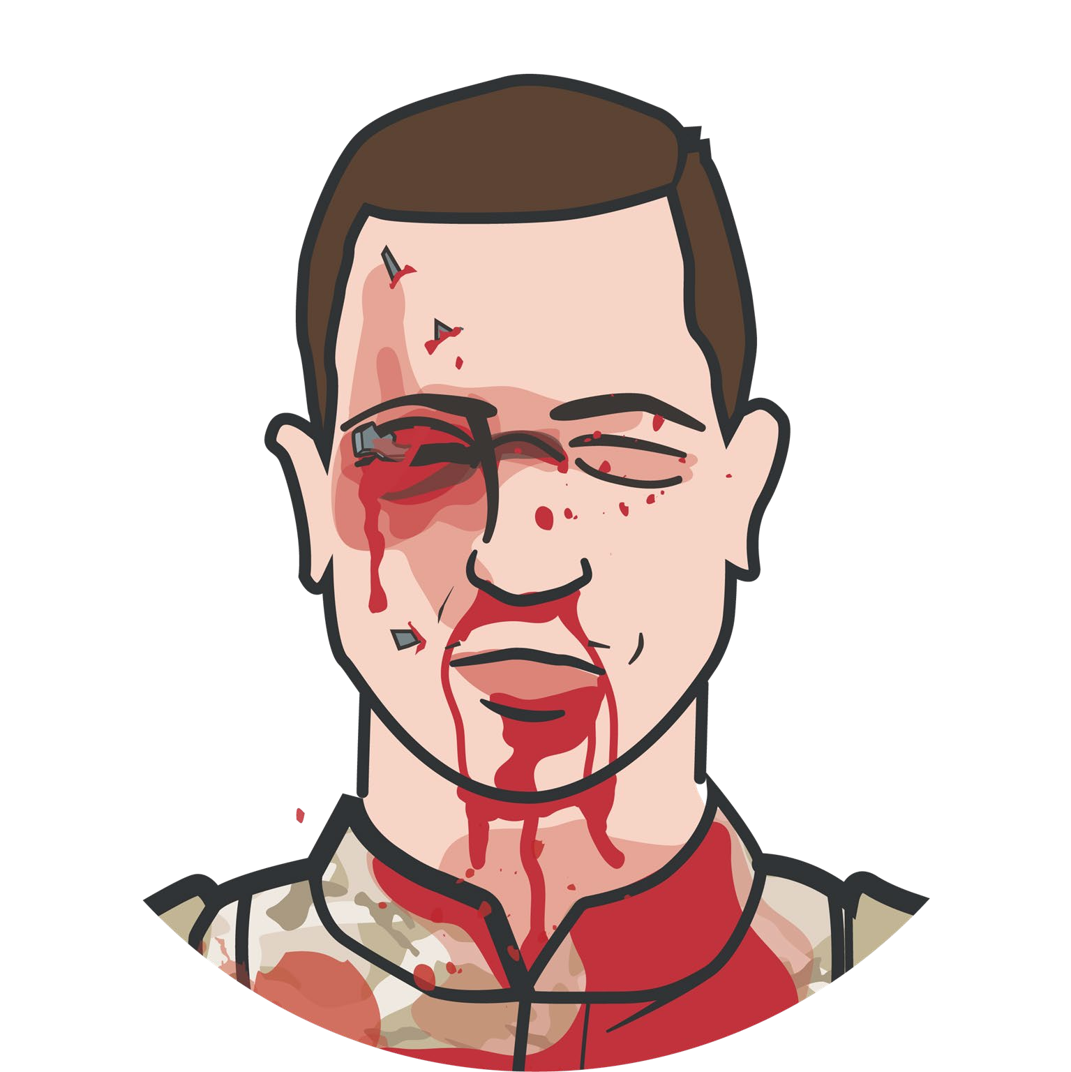

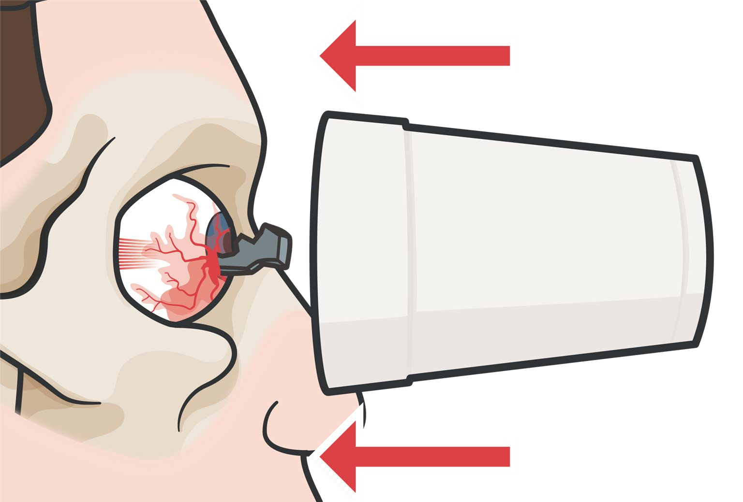

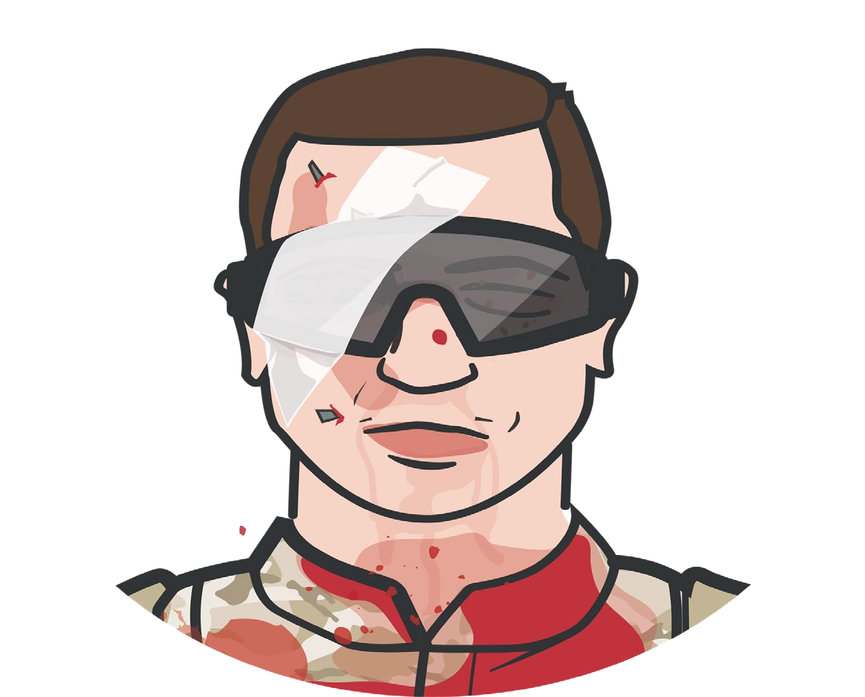
IMPROVISED EYE SHIELD
Module 14: Eye Injuries
APPLY AN IMPROVISED EYE SHIELD
An improvised eye shield can be a Styrofoam or plastic cup applied to protect an injured eye
IMPORTANT!
DO NOT APPLY PRESSURE
Avoid placing dressings or bandages between eye shield and injured eye
M A R C
H
Level of Evidence: C-LD
#TCCC-CPP-PPT-12 08 AUG 23 13

Slide 14

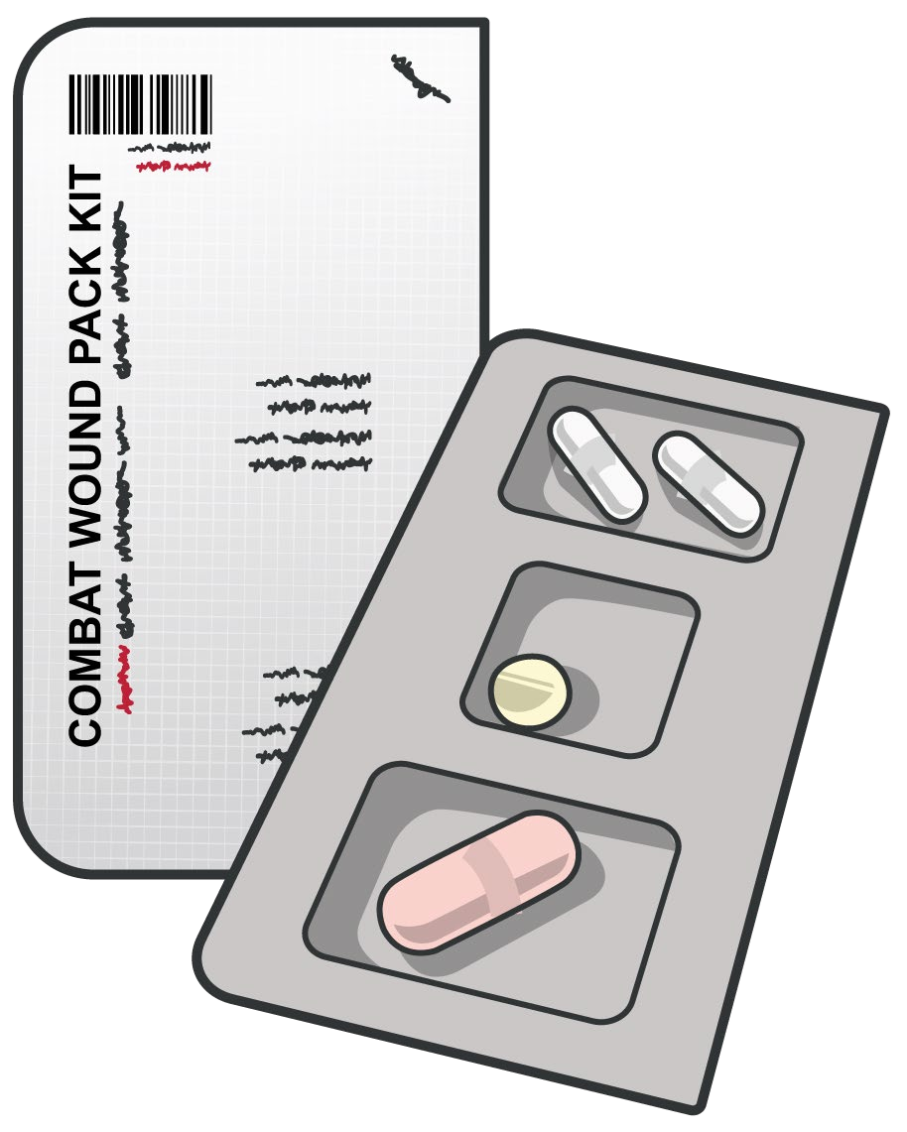


ADMINISTER ANTIBIOTICS
Module 14: Eye Injuries
If the casualty is conscious, ensure administration of the complete combat wound medication pack (CWMP) including 400 mg MOXIFLOXACIN tablet by mouth
If the casualty is unconscious or in shock and cannot swallow, administer 1-gram ERTAPENEM IV/IM/IO
Antibiotics should be administered as soon as possible after wounding
IMPORTANT CONSIDERATION:
Topical antibiotic drops or ointments are not recommended for penetrating eye injuries in TCCC
Know unit members’ allergies prior to deployment and determine alternate antibiotics, as needed
Level of Evidence: B-NR
M A R C H
#TCCC-CPP-PPT-12 08 AUG 23 14
Notes:
Administer an antibiotic as soon as possible after wounding to help prevent the development of posttraumatic endophthalmitis, a bacterial infection of the anterior and/or posterior chambers inside the eye. This type of intraocular infection typically has devastating impact on long-term visual acuity, with only 30% of victims in one study retaining visual acuity greater than or equal to 20/400.
Staphylococcus epidermidis is the most common pathogen implicated, but Bacillus cereus is another very aggressive pathogen often isolated in traumatic intraocular infections.
The casualty with a penetrating eye injury needs broad-spectrum coverage with an antibiotic that has good penetration into the eye, which many antibiotics do not have.⁹ Moxifloxacin 400 mg once a day, given as soon as possible after wounding, is the treatment of choice in the prehospital environment.
If the casualty is conscious and is able to take medications by mouth, administer the Combat Wound Medication Pack (CWMP). If the casualty is unconscious, in shock, or unable to take oral medications, ertapenem, 1 gm IV, IO, or IM should be administered. No topical antibiotics (ointments or eye drops) should be used on a penetrating injury of the eye, as their administration may further damage the injured eye. Antibiotic administration will be covered in more detail in a later module.
The level of evidence supporting the guidance for the initiation of early antibiotic therapy is based on retrospective, observational studies, and subject matter expert consensus.
REMEMBER:
If left untreated, even apparently minor eye injuries can become infected and cause loss of vision or even blindness.

Slide 15
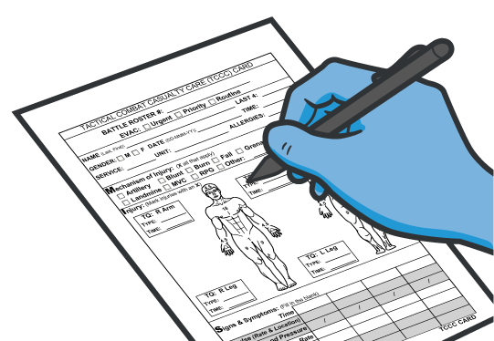
DOCUMENT TREATMENT
Module 14: Eye Injuries
Document all findings and treatments on the DD Form 1380 and attach it to the casualty
Include results of rapid visual acuity test
Include any medications administered and the time administered
M A R C H
Notes:
Document all assessments and treatments on the casualty’s DD Form 1380 and attach it to the casualty. Be sure to include the visual acuity and any medications administered with the time administered.

Slide 16

Module 14: Eye Injuries
APPLYING THE RIGID EYE SHIELD
Video can be found on deployedmedicine.com
Notes:
This video demonstrates the proper application of a rigid eye shield on a casualty with a suspected traumatic eye injury. Note that care is taken to avoid further manipulation of the eye and to avoid applying any pressure to the eye while treating the casualty.

Slide 17

Module 14: Eye Injuries
ASSESSING THE EVIDENCE FOR GUIDELINES
Level of Evidence | AHA Recommendation System Terminology Explanation | Why the AHA Classification System?
A | Evidence from multiple randomized clinical trials (RCT) with concordant results or from HIGH-QUALITY meta-analyses. | The level of evidence recommendations allow readers to quickly glean information on the strength, certainty, and quality of evidence supporting each recommendation. A recommendation with Level of Evidence (LOE) C does not imply that the recommendation is weak. Although, RCTs are unavailable, there may be a very clear clinical consensus that a particular test or therapy is useful or effective.
B-R | Evidence from moderate-quality trials, or a meta-analysis of moderate quality (RCT) followed by an R to denote RANDOMIZED studies
B-NR | Evidence from moderate-quality trials, or a meta-analysis of moderate quality followed by NR to denote NON-RANDOMIZED studies
C-LD | There is no convincing evidence and is followed by LD to indicate LIMITED DATA
C-EO | There is no convincing evidence and is followed by EO if the consensus is based on EXPERT OPINION, case studies or standards of care.
Notes:
Evidence-based recommendations and guidance are the result of a careful review of studies and discussion by a panel of subject matter experts. For TCCC, the subject matter expert panels include both Committee on TCCC members and select invited subject matter experts from within both the military and civilian community, based on the specific interest area.
Why the AHA Classification System?
The level of evidence classification combines an objective description of the existence and the types of studies supporting the recommendation and expert consensus, according to 1 of the following 3 categories:¹⁵
Level of evidence A: recommendation based on evidence from multiple randomized trials or meta-analyses
Level of evidence B: recommendation based on evidence from a single randomized trial or nonrandomized studies
Level of evidence C: recommendation based on expert opinion, case studies, or standards of care.
The level of evidence recommendations allows readers to quickly glean information on the strength, certainty, and quality of evidence supporting each recommendation. The Level of Evidence (LOE) denotes the confidence in or certainty of the evidence supporting the recommendation, based on the type, size, quality, and consistency of pertinent research findings.¹⁶
A recommendation with level of evidence C does not imply that the recommendation is weak. Many important clinical questions addressed in guidelines do not lend themselves to clinical trials. Although, Randomized Clinical Trials are unavailable, there may be a very clear clinical consensus that a particular test or therapy is useful or effective.

Slide 18

Module 14: Eye Injuries
EVIDENCE SUPPORTING TCCC EYE TRAUMA ASSESSMENT
AND INITIAL TREATMENT STRATEGIES
Subject Category | Study Types | Level of Evidence
Perform Rapid Field Test of Visual Acuity | Retrospective, Observational Studies | B-NR
Apply a Rigid Eye Shield | Subject Matter Expert Consensus | C-LD
Initiate Early Antibiotic Therapy | Retrospective, Observational Studies Subject Matter Expert Consensus | B-NR
Notes:
The evidence supporting the eye trauma assessment and initial management strategies in Tactical Field Care is variable. For some of the recommendations, there is clear-cut supporting evidence, while for others a consensus of subject matter expert opinions has informed the guidance.
The rapid field test of visual acuity at the time of traumatic eye injury has been described in the literature¹⁰ and retrospective reviews and observational studies have provided a moderate level of evidence supporting initial visual acuity after injury as the most important predictor of overall outcomes in traumatic eye injuries.¹¹
The need to protect the traumatically injured eye from further damage or manipulation with a rigid eye shield is well documented as subject matter expert consensus in textbooks, literature, and consensus guidelines.¹²
Like the overall indications for the use of and early administration of antibiotics in the traumatically injured casualty in general (which will be discussed in a later module), the initiation of early antibiotic therapy in penetrating eye injuries in the Tactical Field Care phase of TCCC is supported by low-moderate quality of evidence from retrospective/observational studies 13 and subject matter expert consensus guidelines.¹⁴

Slide 19

SKILL STATION
Module 14: Eye Injuries
Eye Injuries (skills)
Rapid Field Visual Acuity Testing Application of a Rigid Eye Shield
Notes:
The following skill cards will demonstrate and help you practice rapid field visual acuity testing and the application of a rigid eye shield.

Slide 20
SUMMARY
Module 14: Eye Injuries
Knowledge Topics
Basic care of an eye injury
Use of a pressure patch is NOT recommended to treat eye injuries
Eye injury treatment strategies are evidence-based
Skills and Abilities
Perform the Rapid Field Test of Visual Acuity
Apply a rigid eye shield
Notes:
If a penetrating eye injury is noted or suspected:
1. Perform a rapid field test of visual acuity and document findings
Rapid visual acuity testing includes the ability to read print, count fingers, identify hand motion, and/or differentiate light from dark.
2. Cover the affected eye with a rigid eye shield, NOT a pressure patch
A pressure dressing could result in permanent loss of vision.
Place a rigid eye shield on only one eye, unless both eyes are injured.
Covering both eyes turns an otherwise ambulatory casualty into a litter casualty.
Tactical eyewear is a good way to prevent eye injuries and can also be used for covering an injured eye if no eye shield is available.
3. Administer the casualty’s complete Combat Wound Medication Pack (CWMP), including all the medications contained in it.
One of the medications is 400 mg of moxifloxacin, which is administered for eye injuries to prevent infection.
IV/IM/IO antibiotics should be administered if oral moxifloxacin cannot be taken by the casualty.
Penetrating eye trauma may not always be obvious injuries from bullets or shrapnel. A cut or laceration of the eye can be subtle and have the same effect allowing contents to leak from the eye. If left untreated, even apparently minor eye injuries can become infected and cause loss of vision or even blindness.
Remember
Document all findings (including visual acuity) and treatments on the casualty’s DD Form 1380.
ALL suspected penetrating eye injuries should be evacuated to a higher level of care as soon as possible.

Slide 21

CHECK ON LEARNING
Module 14: Eye Injuries
What kind of dressing should be used on penetrating eye trauma with an impaled object?
When should a pressure dressing be used in treating traumatic eye injuries?
True or False: The Snellen Eye Chart is used for performing a rapid field visual acuity test?
True or False: Only the injured eye should be covered with an eye shield?
True or False Topical antibiotics and drops are authorized antibiotic treatment for the CPP in TCCC?
Notes:
To close out this module, check your learning with the questions below (answers under the image).
Answers
What kind of dressing should be used on penetrating eye trauma with an impaled object?
A rigid eye shield should be used to cover and protect the injured eye.
Alternatively, an improvised eye shield (Styrofoam or other cup, etc.) taped over the eye can be used if there is a protruding foreign body in the eye that would extend beyond the rigid eye shield.
Tactical protective eyewear can be used to protect the injured eye.
A pressure dressing or patch should NOT be used.
When should a pressure dressing be used in treating traumatic eye injuries?
A pressure dressing or patch should NEVER be used to treat a traumatic eye injury.
True or False: The Snellen Eye Chart is used for performing a rapid field visual acuity test.
False.
Rapid visual acuity testing is NOT a formal vision screening with a Snellen Eye Chart.
It is a rapid assessment and includes testing the casualty’s ability to read print, count fingers, identify hand motion, or differentiate light from dark.
True or False: Only the injured eye should be covered with a rigid eye shield.
True.
Rigid eye shields should be placed over both eyes ONLY when you are sure or at least strongly suspect that both eyes have been injured.
When only one eye has been injured, do not place an eye shield over the unaffected eye to prevent eye movement.
Movement has not been shown to worsen the outcome for the injured eye.
Blindness, resulting from placing eye shields over both eyes unnecessarily, is psychologically stressful and makes an otherwise ambulatory casualty a litter casualty.
True or False: Topical antibiotics and drops are authorized antibiotic treatment for the CPP in TCCC.
False.
Topical antibiotic drops or ointments are not recommended for penetrating eye injuries in TCCC.

Slide 22




Module 14: Eye Injuries
ANY QUESTIONS?

Slide 23

REFERENCES
Module 14: Eye Injuries
TCCC: Guidelines
by JTS/CoTCCC
These guidelines, updated regularly, are the result of decisions made by CoTCCC in exploring evidence-based research on best practices.
PHTLS: Military Edition, Chapter 25
by NAEMT
Prehospital Trauma Life Support (PHTLS), Military Edition, teaches and reinforces the principles of rapidly assessing a trauma patient using an orderly approach.
Notes:
¹ Blanch R, Scott R. Military Ocular Injury: Presentation, Assessment, and Management. J Royal Army Medical Corps. 2009;155(4):279-284.
² Thomas R, McManus JG, Johnson A, Mayer P, Wade C, Holcomb JB. Ocular Injury Reduction from Ocular Protection Use in Current Combat Operations. J Trauma. APR 2009; 66(4): 99-103.
³ Godbole N, Seefeldt E, Raymond W, Karesh J, Morgenstern A, Egan J, Colyer M, Mazzoli R. Simplified Method for Rapid Field Assessment of Visual Acuity by First Responders After Ocular Injury. Military Medicine. Apr 2018; 183 (Suppl 1): 219-223.
⁵ Office of the Surgeon General, Dept of the Army (Thach AB, ed.). Ophthalmic Care of the Combat Casualty. Textbook of Military Medicine. Borden Institute. 2003.
⁶ Office of the Surgeon General, Dept of the Army. Ocular Injuries (Chapter 14). Emergency War Surgery, 5th US Edition. Borden Institute. 2018: 199-212.
⁷ Patterson R, Drake B, Tabin G, Butler F, Cushing T. Wilderness Medical Society Practice Guidelines for Treatment of Eye Injuries and Illness in the Wilderness (2014 Update).
⁸ Gensheimer W, Mazzoli R, Reynolds M, et al. Joint Trauma System Clinical Practice Guidelines for Initial Care of Eye Trauma (Jun 2021 Update).
⁹ Kressloff MS, Castellarin AA, Zarbin MA. Endophthalmitis. Surv Ophthalmol. 1998;43(3):193–224.
¹⁰ Prior reference 3
¹¹ Prior reference 4
¹² Prior references 5,6,7,8
¹³ Prior reference 9
¹⁴ Prior references 5,6,7,8
¹⁵ Tricoci P, Allen JM, Kramer JM, Califf RM, Smith Jr SC. Scientific Evidence Underlying the ACC/AHA Clinical Practice Guidelines. American Medical Association. 2009 Feb; Vol 301, No. 8.
¹⁶ Halparin, JL. Further Evolution of the ACC/AHA Clinical Practice Guideline Recommendation Classification System. American College of Cardiology Foundation and the American Heart Association. 2016 Apr; 133:1426-1428.
Evidence Based References
Blanch R, Scott R. Military Ocular Injury: Presentation, Assessment, and Management. J Royal Army Medical Corps. 2009;155(4):279-284 C-LD
Gensheimer W, Mazzoli R, Reynolds M, et al. Joint Trauma System Clinical Practice Guidelines for Initial Care of Eye Trauma (Jun 2021 Update). C-EO
Godbole N, Seefeldt E, Raymond W, Karesh J, Morgenstern A, Egan J, Colyer M, Mazzoli R. Simplified Method for Rapid Field Assessment of Visual Acuity by First Responders After Ocular Injury. Military Medicine. Apr 2018; 183 (Suppl 1): 219-223 C-LD
Gondusky JS, ReiterMC. Protectingmilitary convoys in Iraq: An examination of battle injuries sustained by a mechanised battalion during operation Iraqi Freedom II. Mil Med 2005;170;546-549 B-NR
Kressloff MS, Castellarin AA, Zarbin MA. Endophthalmitis. Surv Ophthalmol. 1998;43(3):193–224. B-NR
Kuhn F, Maisiak R, Mann L, Mester V, Morris R, Witherspoon C. The Ocular Trauma Score (OTS). Ophthalmol Clin North Am. 2002; 15(2): 163-165 B-NR
Office of the Surgeon General, Dept of the Army (Thach AB, ed.). Ophthalmic Care of the Combat Casualty. Textbook of Military Medicine. Borden Institute. 2003. C-LD
Office of the Surgeon General, Dept of the Army. Ocular Injuries (Chapter 14). Emergency War Surgery, 5th US Edition. Borden Institute. 2018: 199-212. C-LD
Patterson R, Drake B, Tabin G, Butler F, Cushing T. Wilderness Medical Society Practice Guidelines for Treatment of Eye Injuries and Illness in the Wilderness (2014 Update). B-R
Thomas R, McManus JG, Johnson A, Mayer P, Wade C, Holcomb JB. Ocular Injury Reduction from Ocular Protection Use in Current Combat Operations. J Trauma. APR 2009; 66(4): 99-103 B-NR

